Slide 1
Disability (Health/Patient-Centered) Research
Katherine McDonald, PhD
Notes:
Two things before we get started

Slide 2
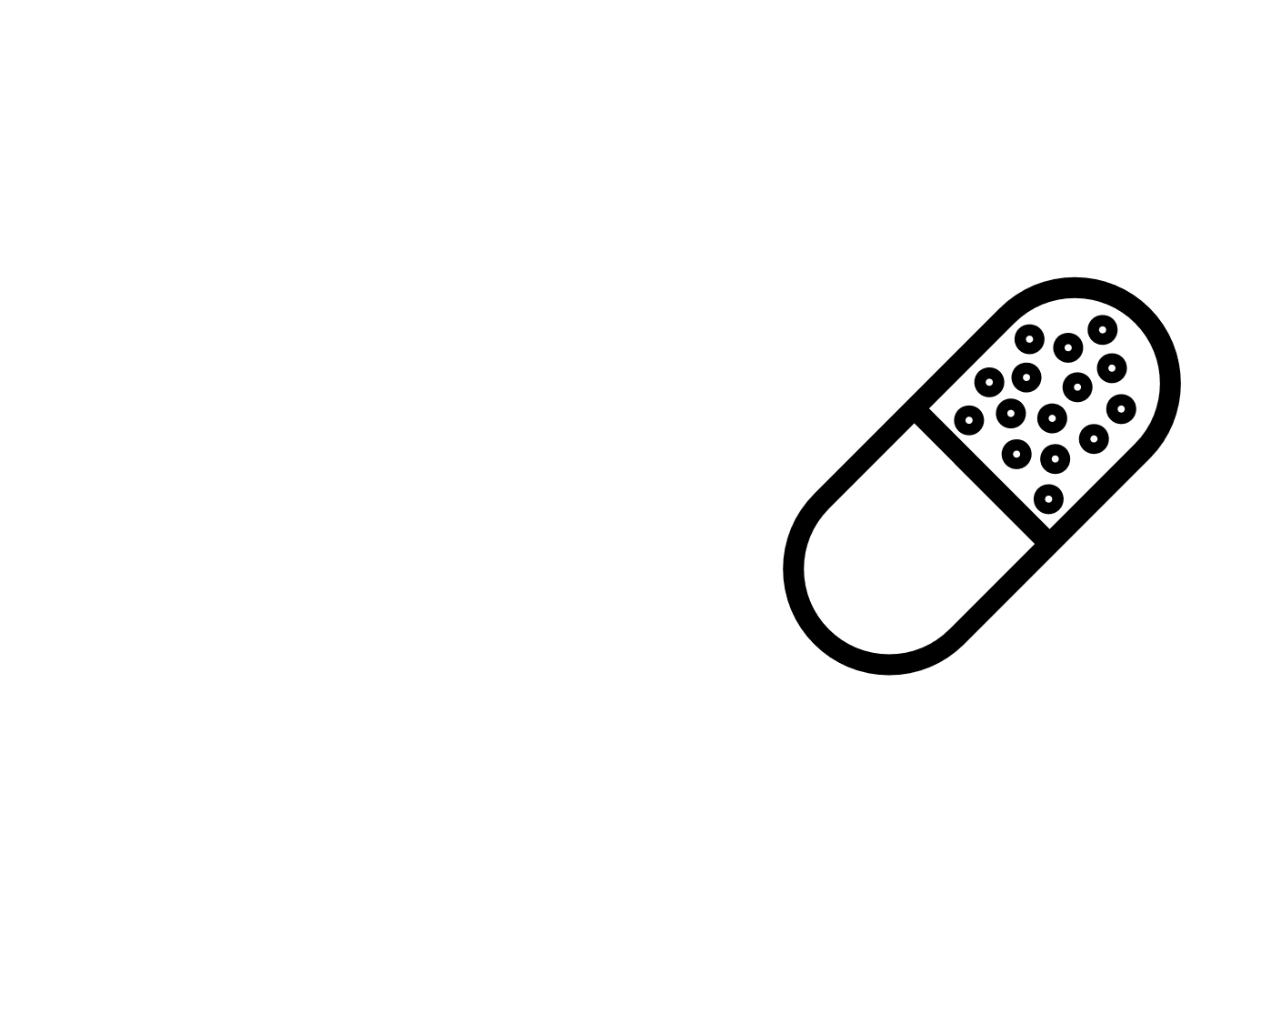
Scientific Health (Patient-Centered) Research
Thinking
Feeling
Doing
Health outcomes
Quality of Life
Notes:
a systematic investigation, including research development, testing and evaluation, designed to develop or contribute to generalizable knowledge … sometimes with human subjects

Slide 3
Overview
Research and people with disabilities
Yesterday
Today
Tomorrow

Slide 4
Yesterday
In the past, many people were harmed for “scientific research”
Notes:
The history of “human experimentation” is peppered with instances of exploitation and abuse

Slide 5
Willowbrook (1956 – 1971)
New York state institution for children with developmental disabilities
Studied the natural history of hepatitis
Infected children with hepatitis (fed with stool extracts; injections)
Families could bypass waitlist for admittance by agreeing to participate in the research
Parents not well informed of risks
Notes:
Researchers justified their actions because said many children would contract hepatitis anyway by virtue of living in an institution – better to be infected under controlled conditions
Parents were told their children were receiving vaccinations

Slide 6
Today
People with disabilities experience negative health outcomes (health and healthcare disparities)
Scientific research may help us promote health

Slide 7
Today
Marginalization, ethical challenges and feelings of distrust/disrespect may discourage and limit research with people with disabilities
A lot of research does not include people with disabilities
People with disabilities have little influence on research
Research does not always address the priorities of people with disabilities
Research outcomes do not always include knowledge translation
Notes:
Implicit and explicit exclusion
Informed consent challenges
Concerns may be harmed/unable to participate
Disability as confound
Trust/accommodations and recruitment
But people with developmental disabilities are frequently excluded from participation in knowledge production. They are frequently excluded, or insufficiently represented, on grant review boards, research advisory boards, or in public policy discussions. Nor are they often given legitimacy as experts on their own experience, because lived experience is not the type of knowledge that is currently well-valued by society--especially lived experience by someone who is viewed as mentally impaired. A scientist or professional--or even a family member--is frequently listened to first, even when their point of view contradicts that which the person with the disability says is true.
Furthermore, self-advocates may be under-represented in academic settings, in public office, and in settings such as summits and seminars where stakeholder input is solicited. Which makes it even harder to influence knowledge production.
And while lay people such as parents or non-scientific professionals may be included in research and policy as public members, they are not substitutes for the self-advocates themselves. In fact, parent and professional stakeholders may have priorities and agendas which conflict not only with each other but with the objectives of the self-advocate community as well.

Slide 8
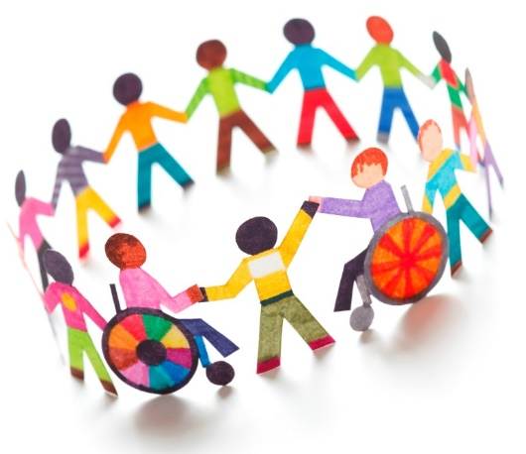
Tomorrow
How do we pursue the safe, respectful inclusion of people with disabilities in health research?
Notes:
Key issues/considerations
Exploitation → Protection (exclusion) → Access
Social and scientific consequences
Voice, paternalism, representation
Balance autonomy with protections
Research that serves people with disabilities
Diversity of people with disabilities (intersectionality)

Slide 9
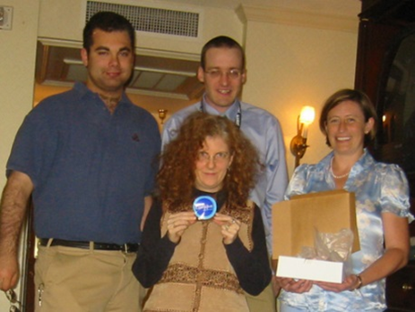
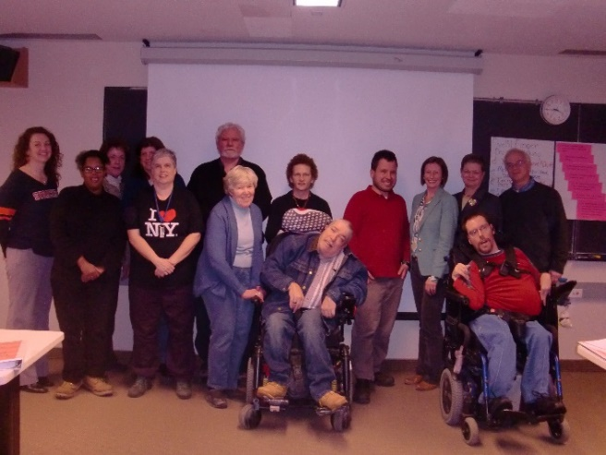
Nothing About Us Without Us
Direct involvement by people with disabilities in things that impact their lives
Inclusion of people with disabilities as research partners and participants
Notes:
Need to infuse disability rights/human rights perspective into research conversations and decisions.
What does respect in research mean to long marginalized group?
Self-advocates vs. parents / professionals
People with disabilities as direct respondents
Proxy report → Bias, validity concerns
Representative of proxy not of people with disabilities
Proxy information not always valid
Some statistic from a study
Bias (e.g., asking parents to assess the quality of their adult children’s relationships)
Consent by the subject of the proxy report – is it done?
Disability rights, human rights, strengths-based models, and the social model of disability are all powerful foundations and frames for research. But is DD research currently built on those foundations, viewed through those frames?
And why is it so important that people with developmental disabilities are included in all phases of the research process? Why should they care about being included?
And does current research even address the needs of people with developmental disabilities in the first place?
Ethically addressing the needs of people with developmental disabilities in research means pursuing research that is worthwhile and meets the needs of people with developmental disabilities. It means asking research questions people with developmental disabilities themselves feel are relevant, and delivering interventions the recipients themselves desire.
Addressing the needs of people with developmental disabilities in research means promoting research that has direct and indirect benefits to those people as stakeholders. This includes providing new opportunities and personal enrichment. It also includes enabling people to have more influence on policy, research, and society.
Some ways to facilitate these things are to acknowledge people with developmental disabilities as a primary stakeholders and include them on grant review panels. on research-related advisory boards. in DD policy, where that policy has influence on science or vice-versa. As primary stakeholders with an important and legitimate perspective. And, of course, as members of a research team. Which I’ll get back to in a moment.
So what do you get for all that added hassle? Well, there are many ethical—and other—bonuses with participatory research. Done right, you get people with developmental disabilities included equitably in all stages of the the research process. This gets you research questions that they find relevant, and interventions they want. It helps produce research that is respectful, and that includes civil rights framing. It gets you—and your participants—accessible study materials, including understandable consents. It gets people with developmental disabilities both potential benefits from the research and from participating in the research process.
And, lastly, it has the potential to get you better science, because you have increased access to the population of interest, better designed studies, more trustworthy conclusions, and have research participants who are motivated to participate in your study because they truly care about its outcome.

Slide 10
Desire for Inclusion
We're part of the community . . . everybody has something to give . . . why should people be excluded because there's something wrong with their legs or something wrong with their arms or something wrong with something else?
You need to let your voice be heard
I know that for things to change [researchers] need my input
[There are] different insights with different people like the professional and the self-advocates and the investigators. You learn from one another.
Notes:
Most people support the direct inclusion of PWD in research, and most want to be in research
SFY surveys

Slide 11
Research Partners
Nicolaidis, C., Raymaker, R., McDonald, K., Robertson, S., Dern, S., & Ashkenzy, E. (2011). Collaboration strategies in non-traditional CBPR partnerships: Lessons from a geographically-dispersed partnership with autistic self-advocates. Progress in Community Health Partnerships: Research, Education, and Action, 5, 143-150.
Notes:
Revolutionary way to do science!

Slide 12
Research Partners
Research questions and methods
Relevant questions and desired interventions
Respectful research and equitable inclusion (human rights, dignity, inclusion, priorities)
Accessible research participation
Less harm
Personal and community benefits
Better science and better community outcomes!
It seems more accurate because then the questions change so they would understand it and they would be answered more accurate that way too.
Notes:
Addressing the needs of people with developmental disabilities in research means promoting research that has direct and indirect benefits to those people as stakeholders. This includes providing new opportunities and personal enrichment. It also includes enabling people to have more influence on policy, research, and society.
Some ways to facilitate these things are to acknowledge people with developmental disabilities as a primary stakeholders and include them on grant review panels. on research-related advisory boards. in DD policy, where that policy has influence on science or vice-versa. As primary stakeholders with an important and legitimate perspective. And, of course, as members of a research team. Which I’ll get back to in a moment.
So what do you get for all that added hassle? Well, there are many ethical—and other—bonuses with participatory research. Done right, you get people with developmental disabilities included equitably in all stages of the the research process. This gets you research questions that they find relevant, and interventions they want. It helps produce research that is respectful, and that includes civil rights framing. It gets you—and your participants—accessible study materials, including understandable consents. It gets people with developmental disabilities both potential benefits from the research and from participating in the research process.
And, lastly, it has the potential to get you better science, because you have increased access to the population of interest, better designed studies, more trustworthy conclusions, and have research participants who are motivated to participate in your study because they truly care about its outcome.
Inclusion – greater opportunity to share perspective, experiences, and lived expertise in influencing or controlling research that affects their lives. Some authors noted that this focus on inclusion is more ethical and provides a way to break down barriers between professional researchers and community members.
Empowerment - provide greater opportunities for adults with developmental disabilities to gain knowledge and understanding. Authors note that as community members learn new skills and build confidence, and experience increased feelings of autonomy and independence, these outcomes may positively influence their lives more generally.
Expertise - This expertise can shed light on the study of phenomenon with which they have personal experience related to measurement, interpretation of findings, and recommendations.
Facilitators (90%)
Formal structures (42%)
Using a variety of strategies to promote accessibility (42%)
Professional researchers’ self-awareness, openness, & flexibility (21%)
Community partners’ development and growth (21%)
Community partners’ eagerness and feelings of ownership (21%)
Identifying clear roles for all project members (11%)
Paying community partners (5%)
Challenges (81%)
Difficulties making project accessible (63%)
Failure to set up formalized decision making procedures (13%)
Adherence to academic guidelines (13%)
Funding community members (13%)
Difficulty ending partnership (13%)
Transportation (6%)
Power imbalances (6%)
Differences among group members (6%)

Slide 13
Accessible, Respectful Research on Outcomes Important to People with Disabilities and Increased Knowledge Translation

Slide 14
Accessible Research
Remove barriers, provide supports
Accessible locations
Varied recruitment
Specific information on where to go, who to contact
Invite/offer support provider if desired
Accessible materials (plain language, picture boards, asynchronous communication)
Read materials out loud
Assistance with paperwork
Demonstrate procedures
Accommodations for one participant may not be the needed accommodations for another participant (flexible)
Notes:
Also threaded throughout your research design should be considerations for how to remove barriers to and provide supports for participation by PWIDD.
That is, ethical research is accessible research (accommodations and supports). And these are FRONT END issues that matter until you have completed the research cycle. Like most of what we are discussing today, more ethical research often also makes for more valid research (representativeness of sample, accuracy of responses, fuller interpretive lens)

Slide 15
Your Tomorrow -- Get Involved!
Serve on a grant review panel
Be a research partner
Be a research participant
Questions to consider:
Do I think this research is important?
Is this research respectful?
What are the (legal, social, economic, psychological, physical) risks of being a research participant?
What are the (direct and indirect) benefits of this research?
What will the researchers do to keep me from being harmed?

